Slide 1
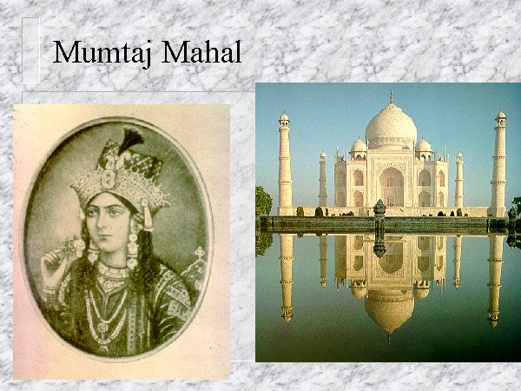
The Great Mughal Empire
1526-1707

Slide 2
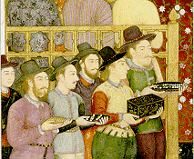
Introduction
Under the Mughals, India was the heart of a great Islamic empire and a prolific center of Islamic culture and learning.
Dynasty was the greatest, richest and longest lasting Muslim dynasty to rule India.
Mongol Descendents
The Great Mughal Emperors were:
  Babur (1526-1530) The First of the Mughals
  Humayun (1530-1556) The Luckless Leader
  Akbar (1556-1605) The Great
  Jehangir (1605-1627) The Paragon of Stability
  Shah Jehan (1627-1658) The Master Builder
  Aurangzeb (1658-1707) The Intolerant

Slide 3

Babur 1526 - 1530
The First of the Mughals
Babur was a direct descendant of the Turkish Ghengis Khan and Timur from Tamerlane. (Rumor has it – Adele)
Defeated the Delhi Sultanate & established the Mughal Empire.
  Gunpowder, a skilled commander, trained soldiers on horses contributed to the victory
Gained control of the whole northern India
  Made Agra capital
He reigned for 4 short years and died at age 47 in 1530.
Did not enact new laws or organization in the empire due to early his death

Slide 4

Humayun 1530 - 1556
The Luckless Leader
After Babur died, he was succeeded by his son Humayun in 1530. Humayun was 23 years old.
He was not a soldier and unlike his father, neither skilled nor a wise leader.
Inherited a disunited and disorganized empire.
In 1540, Sher Shah of Bengal defeated Humayun and took over the Mughal Empire. The Empire was lost from 1540-1545.
  He was exiled but later regained power in 1555.
Humayun died in 1556 after falling down the steps of his library; he is known as “the luckless one”.

Slide 5

Akbar 1556 - 1605
The Great
Akbar become the new Mughal ruler at the age of 14.
  Regent and his mother ruled in his name for 4 years
Akbar was an ambitious and noble commander
  Built the largest army ever in the empire.
  Helped to conquer nearly all of modern-day northern India and Pakistan.
Great administrator
  developed a centralized government
    It delegated 15 provinces each under a governor and each province into districts and each district was further sub-divided into smaller sections.
Best known for tolerance of his subjects (especially Hindus)
  Removed poll taxes on Hindus
Invited religious scholars to debate him in his private chambers.
  Developed his own faith call Din Ilahi.
    Din Ilahi was a mixture of the other religions Akbar had studied from those debates.
    Religion never caught on

Slide 6

Jehangir 1605 - 1627
The Paragon of Stability
Jehangir succeeded his father Akbar in 1605.
Opposite of his father
  Poor monarch and warrior but good at maintaining the status quo.
He continued many of Akbar’s policies.
  Freedom of worship.
  Fair treatment of Hindus.
  Continued friendship and alliance with Rajputs.
  Allowed foreigners like the Portuguese and English into India for trade.
Jehangir married Nur Jahan. She became the real ruler of the empire until the death of her husband.

Slide 7
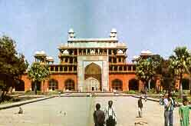
Jehangir Issues (specific)
Under the influence of his wife and many others, Jehangir was not an able ruler like his father.
  He loved to drink and enjoy himself.
  He had to suppress many rebellions.
  Important posts in the court were given to families, friends, and especially those close to his wife, Jahan.

Slide 8

Shah Jehan 1627 - 1658
The Master Builder
Shah Jehan succeeded his father in 1627.
Better ruler than Jehangir.
  Restored the efficiency of government.
  Recovered territories.
  Maintained peace
  Foreign traders were allowed into India and trade increased considerably.
The empire was expanded.
Shah Jehan was a patron of the arts
  Built many great architecture buildings including the Taj Mahal and the Peacock Throne, a brilliant gold throne encased in hundreds of precious gems.

Slide 9
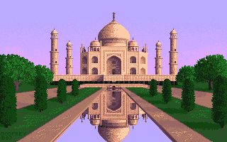
Shah Jehan
Taj Mahal
  Built in honor of his wife who died during childbirth.
  Took over a decade to build and it nearly bankrupted the empire.
1657 - Shah Jehan became seriously ill and a dispute over the succession of the throne ensued between his three sons.
Aurangzeb deposed Shah Jehan in a coup d’etat in 1658. Shah Jehan was imprisoned in the Octagonal Tower of the Agra Fort from which he could see the Taj Mahal. He died in 1666 and was buried next to his wife in the Taj Mahal.

Slide 10

Aurangzeb 1658 - 1707
The Intolerant
Aurangzeb ascended the throne after disposing his father and beating out his two brothers.
Despot
  severely persecuted Hindus of Northern India.
Empire declines under his reign
  He removed the tax-free status for Hindus
  Destroyed their temples
  Crushed semi-autonomous Hindu states
Primary Interest - Promote Islam vs tolerance

Slide 11
Aurangzeb
Aurangzeb over expanded the empire and strained his resources.
  Large sums of money and manpower were lost.
  He lost the support of the Hindu people.
  The over expansion of his empire weakened his administration.
Aurangzeb died in 1707
  s son Bahadur Shah succeeded him. Bahadur was so old by the time he ascended the throne, he only managed to live a few more years. But at this point in time, the government was so unstable and so weak, the empire become an easy target of invasion and exploitation, first by the Persians, and then by the British.
The death of Aurangzeb and the short reign of his son led to the end of the Mughal empire and the beginning of British Rule.

Slide 12
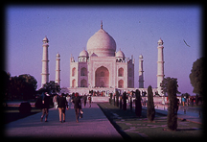
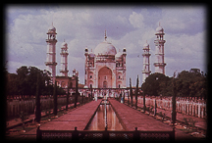
Aurangzeb’s Architectural Legacy
Taj Mahal, Agra 1631-1652
Shah Jehan
Bibi ka Maqbara, Aurangbab 1678
Aurangzeb
Built nearly 50 years apart, the Taj Mahal and the Bibi la Maqbara are very similar in architectural style. Aurangzeb’s other architectural legacy included:
Moti Masjid (Delhi Fort), Delhi (1659)
Buri-I-Shamali (Delhi Fort), Delhi
Badshahi Mosque, Lahore (1674)

Slide 13
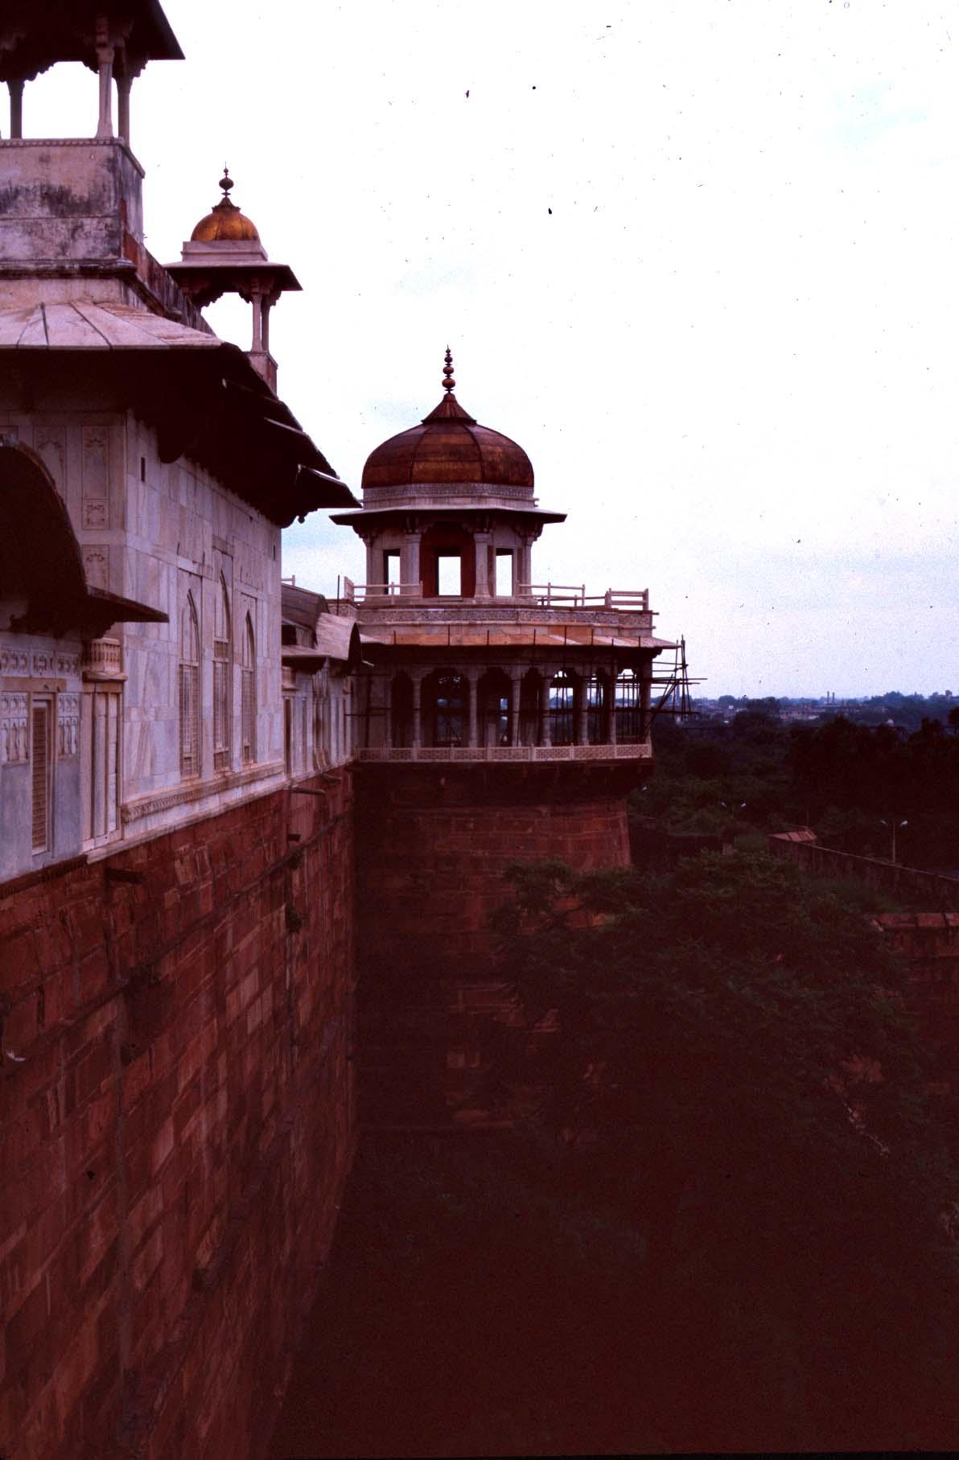

Slide 14
The Success of the Mughals
It is agreed among many scholars that the Mughal empire was the greatest, richest and most long-lasting Muslim dynasty to rule India. This period of Mughal rule produced the finest and most elegant art and architecture in the history of Muslim dynasties.
The Mughal emperors, with few exceptions, were among the world’s most aesthetically minded rules. Although Turkish and Persian in background, the Mughals were not Muslim rulers of India but Indian rulers who happened to be Muslims. This idea is most evident in Akbar’s obsession of a utopian India for Hindus and Muslims.
The longevity of the Mughal empire can be contributed to a number of factors. The Mughal emperors were ambitious and for the most part able rulers. But Akbar is perhaps the Mughal emperor responsible for much of the prosperity and harmony achieved during the Mughal Empire.

Slide 15
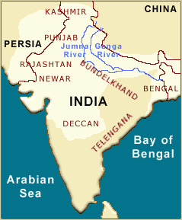

Akbar the Great, as he is referred, perceived that 3 things were needed if his Empire was to be stable and long-lasting.
  1. Fair rent must be fixed for the peasant and a steady revenue for the treasury,
  2. The land must be ruled by men who were impartial and responsible to himself,
  3. The Muslim must live at peace with the Hindu.
Akbar strove during his lifetime to achieve these 3 things. He showed tolerance to Hindu scholars and women.
By 1650, the Mughal empire had expanded farther North and South.

Slide 16
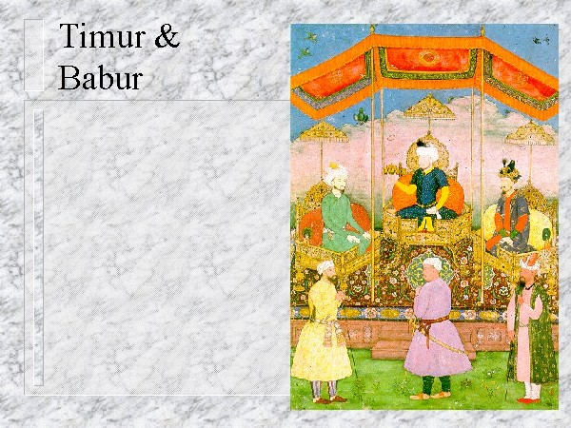
Mughal Art
The Mughal Empire and the Great Mughals will always be remembered as a great influence on the artistic and cultural life of India. Their architectural style can still be seen today such as the Taj Mahal built by Shah Jehan and the buildings at Fatehpur Sikri.
The remarkable flowering of art and architecture under the Mughal Empire is due to several factors.
  The empire provided a secure framework within which artistic genius could flourish. Both Hindu and Muslim artists collaborated to produce some of the best Indian art.
  The empire commanded wealth and resources that were unparalleled in Indian history.
  The Mughal emperors were themselves patrons of art whose intellectual ideas and cultural outlook were expressed in the architecture.

Slide 17
Summary: The Dynasty of the Great Mughals in India
1526-1530 Babur’s victory at Panipat in 1526 established the Mughal Empire and ended the reign of the Delhi Sultanate. The rise of the great Mughal Dynasty in India began with Babur.
1530-1556 Humayun succeeded his father Babur and became emperor. He was defeated and dislodged by insurrections of nobles from the old Lodi regime. In 1540, the Mughal domain came under control of Farid Khan Sur (Shir Shah Sur). Humayun died at the age of 48 when he fell down the steps of his library.
1556-1605 Akbar, the most sophisticated Mughal commander and leader, was only 14 years of age when he succeeded his father Humayun. Under Akbar's reign, Muslims and Hindu’s received the same respect.

Slide 18
Summary: The Dynasty of the Great Mughals in India
1605-1628 Jehangir succeeded his father, Akbar.
1628-1658 Prince Khurram was 35 years old when he ascended the throne as Shah Jehan, King of the World.
1659-1707 In the summer of 1659, Aurangzeb held a coronation in the Red Fort where he assumed the title of Alamgir (World Conqueror). After a bitter struggle with his two brothers, Aurangzeb was the victor who took the throne.
1857 Bahadur Shah II, the last Mughal emperor, was deposed in 1858. India was brought under the direct rule of the British Crown. This brought the end of the Mughal Empire.

